Slide 1
DATA collector

Slide 2
Abstract
Effective data collection is the backbone of informed decision-making in various industries. A Data Collector plays a crucial role in in gathering, recording, and maintaining accurate and reliable data. This paper outlines the key responsibilities, skills, and tools required for a Data Collector to excel in their role. It also highlights the challenges faced by Data Collectors and provides best practices for ensuring high-quality data collection. By understanding the importance of accurate data collection and the role of a Data Collector, organizations can make informed decisions and drive business success.

Slide 3
Key features
Data Entry and Management
Data Validation and Quality Control
Security and Privacy
User-Friendly Interface
Data Analysis and Reporting

Slide 4
Literature survey
This paper provides a comprehensive review of recent developments in the field of big data.
It discusses the challenges of handling large volumes of data and the technologies used to manage and analyze it, such as Hadoop, MapReduce, and NoSQL.
The paper also explores applications of big data in various fields like healthcare, smart cities, and finance.

Slide 5
Existing applications
Education and Academic Research
Environmental Studies
Business and Finance
Collecting data on student performance, learning outcomes, and feedback on teaching methods.
Gathering data on environmental conditions, wildlife populations, and ecological changes through fieldwork.
Collecting data on consumer behavior, market trends, and competitive analysis.

Slide 6
Deviation from Existing applications
Advanced Analytics and AI Integration
Multi-Modal Data Collection
Mobile and Remote Access
Collecting data on student performance, learning outcomes, and feedback on teaching methods.
Gathering data for various academic research projects, including surveys, interviews, and experiments.
While existing data collectors may focus on a single type of data (e.g., text or numerical), a deviation could involve supporting multi-modal data collection, including images, videos, audio, and sensor data, providing a richer dataset for analysis.
Many data collection systems are designed for desktop use. A deviation could involve creating mobile-friendly data collectors that allow users to collect and analyze data on the go. This is particularly useful in field research, remote monitoring, and mobile surveys.

Slide 7
modules
Data Structure Definition Module | Data Input Module | Data Output Module | Memory Management Module | Main Program Module
Define a structure to store user data. | Prompt the user to enter their details and store the input data. | Display the collected user data. | Allocate and free memory for user data. | Main function to execute the program and orchestrate the data collection and display.

Slide 8
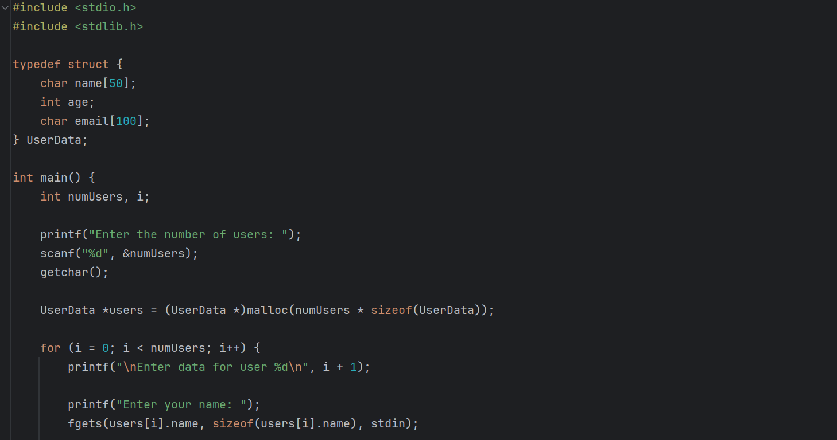
Code snippet

Slide 9
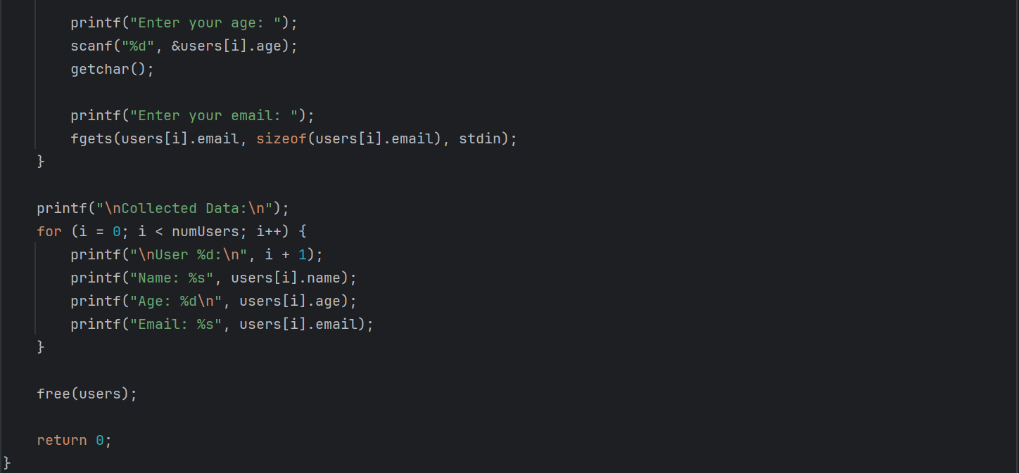

Slide 10
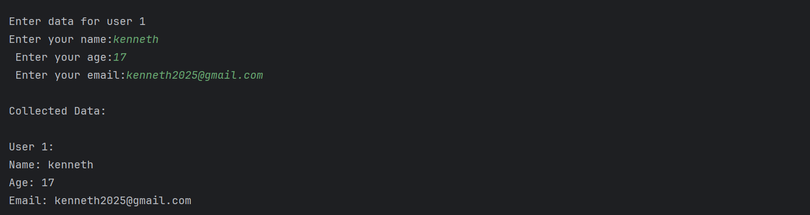
Sample output

Slide 11
Tools used for data collector
Survey and Questionnaire Tools
1.Google Forms: Easy-to-use tool for creating online surveys and questionnaires.
2.SurveyMonkey: Popular platform for designing and distributing surveys.
3.Typeform: User-friendly tool for creating interactive and engaging surveys.

Slide 12
Interview and Focus Group Tools
1.Zoom: Widely used platform for conducting virtual interviews and focus groups.
2.Microsoft Teams: Suitable for remote interviews and group discussions.
Observation Tools
1.Field Notes: Manual recording of observations during fieldwork.
2.Noldus Observer: Software for systematic observation and behaviour analysis.

Slide 13
Data Storage and Management Tools
1.Databases: Systems for storing and managing large datasets (e.g., MySQL, PostgreSQL).
2.Cloud Storage: Platforms for storing data in the cloud (e.g., Google Drive, Dropbox).
Online Research Tools
1.Scraper Tools: Software for extracting data from websites (e.g., Beautiful Soup, Scrapy).
2.Social Media Analytics: Tools for collecting and analyzing data from social media platforms (e.g., Hootsuite, Sprout Social).

Slide 14
any publication targeted yes

Slide 15
Team members
NAME | ROLL NUMBER
D.Keerthisri | 241901047
K.Kenneth Prathap | 241901048
R.Kritheshwaran | 241901049

Slide 16
Thank you

